Slide 1
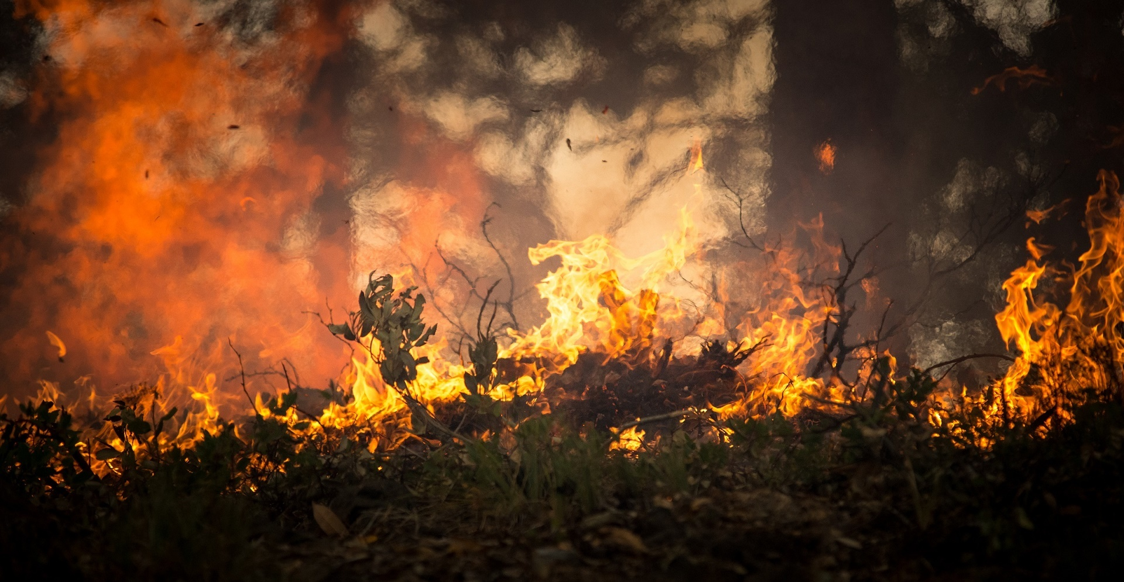
Project-one
An Analysis Sparked By Lightning
John Olton

Slide 2
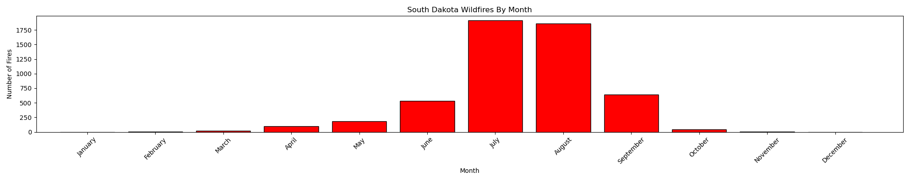
What is each state’s fire season bases on month vs state?
The fire season for my states are July and August. The months outside of them don’t have as many fires as those two months.

Slide 3
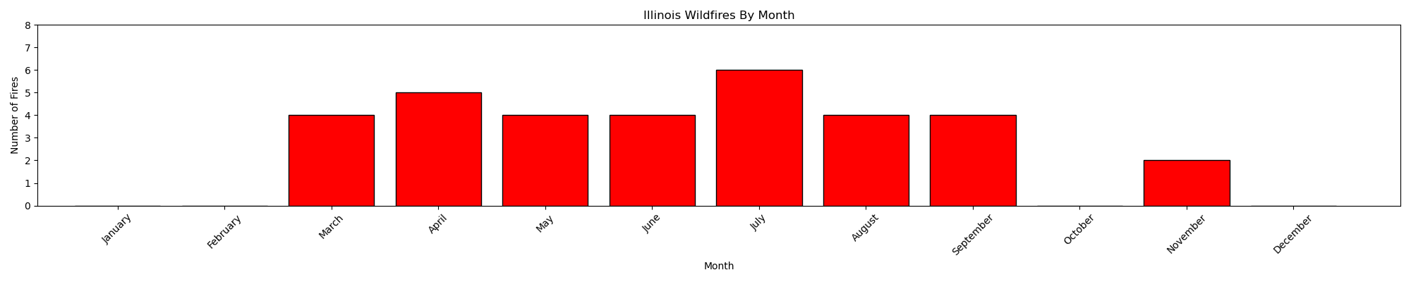
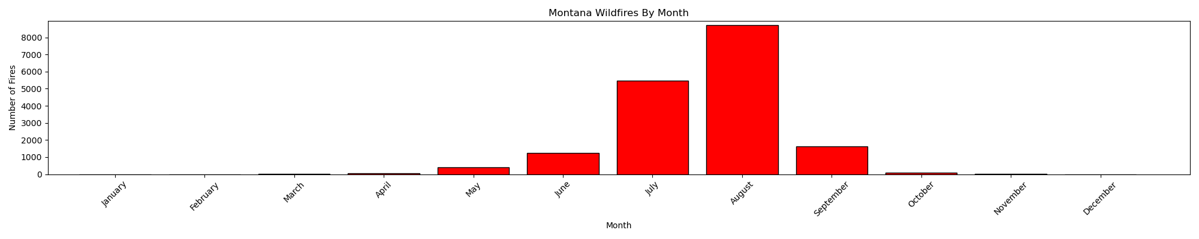
The Difference between a state with 33 fires and a state with almost 250,000.

Slide 4
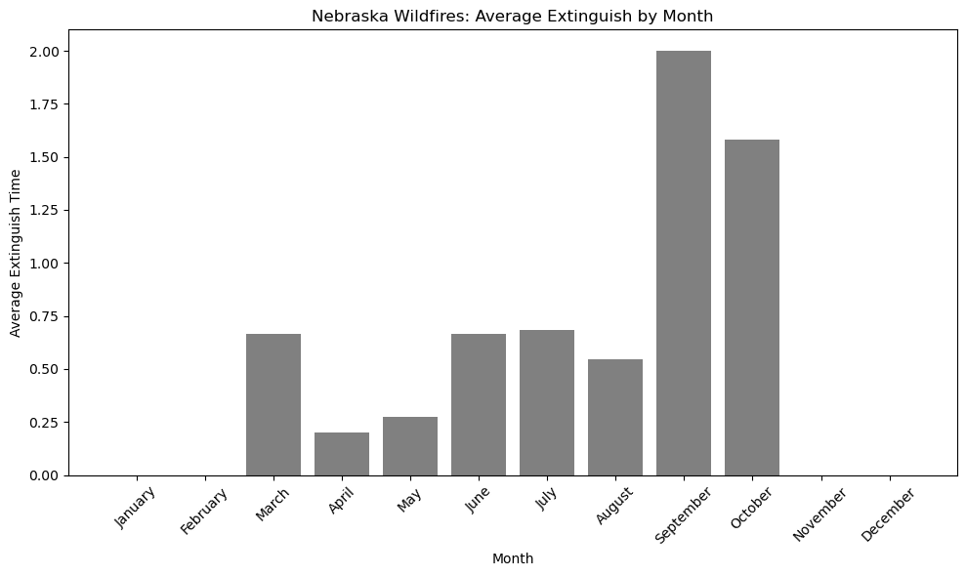
Has fire fighting gotten more efficient/ effective over time?
Yes, it has. Even though there are outliers over time fighting forest fires has gotten more efficient over time.

Slide 5
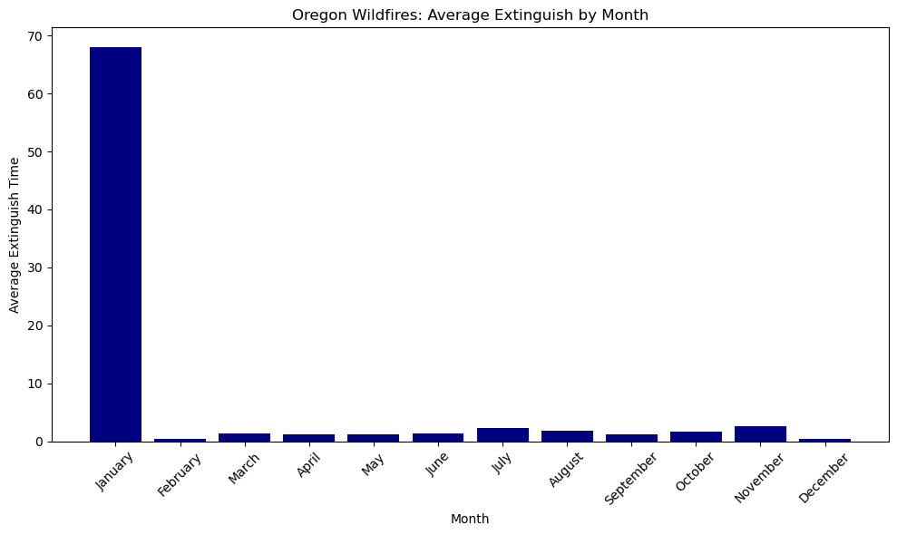
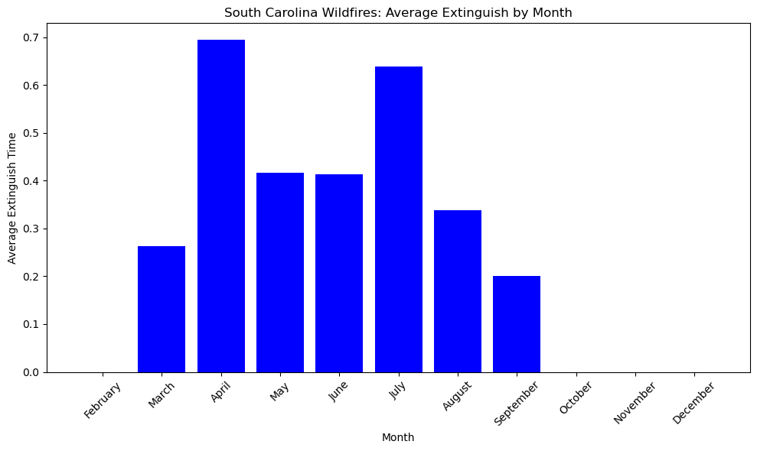
Major outlier for Oregon.
South Carolina mostly consistent and all under a day.

Slide 6
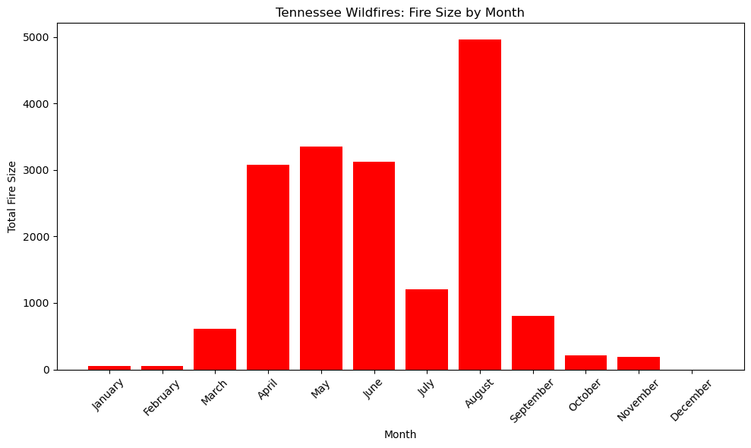
Have fire sizes changed over time? Is there a trend?
Yes. For various reasons. Mostly due to dry spells or hurricanes. The closest thing to a trend I found was that both fire season and some of the biggest fires occurred during the summer.

Slide 7
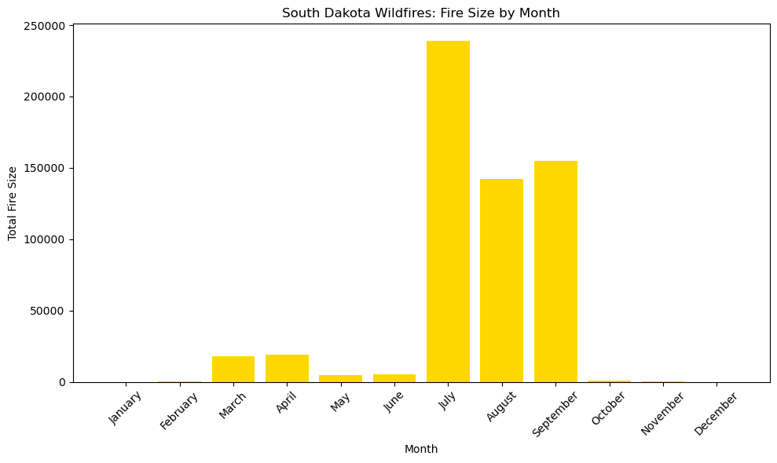
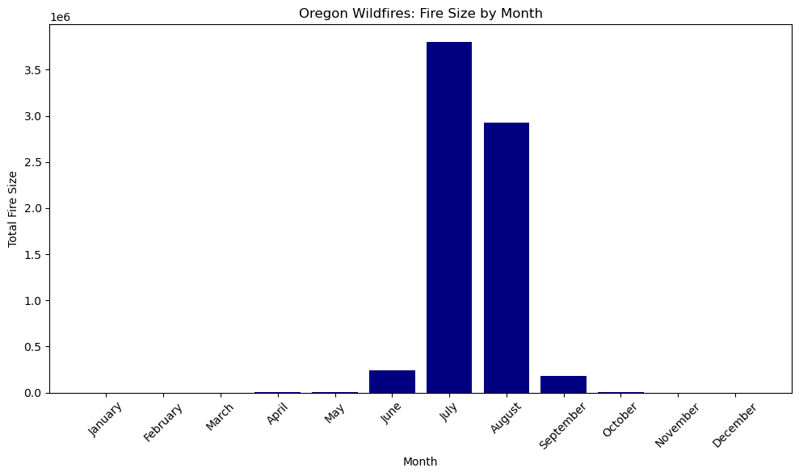
July adds up to almost 250,000 acres in South Dakota.
July in Oregon adds up to approximately 3,500,000 acres.
That is approximately 3,250,000 acres which comes out to almost 5,100 square miles which is larger than Connecticut.

Slide 8
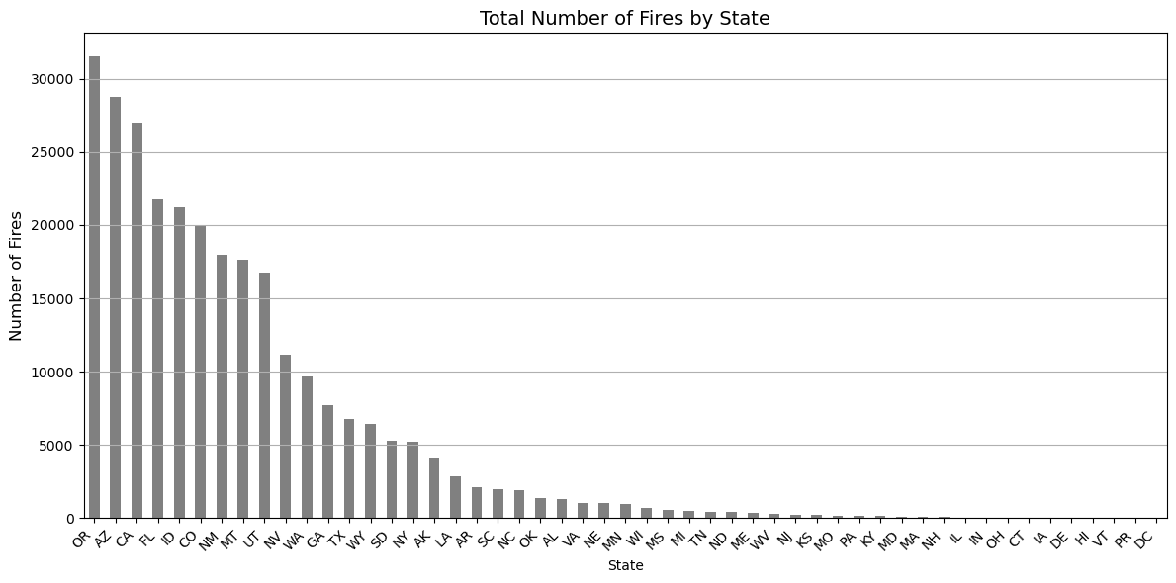
What state’s have the Most fires?
My states with the
most fires in order
Oregon over 31,556
Montana with 17,635
South Dakota with 5,294
South Carolina with 1,996
Nebraska with 1,030
Tennessee with 445
Kansas with 203
Illinois with 33

Slide 9
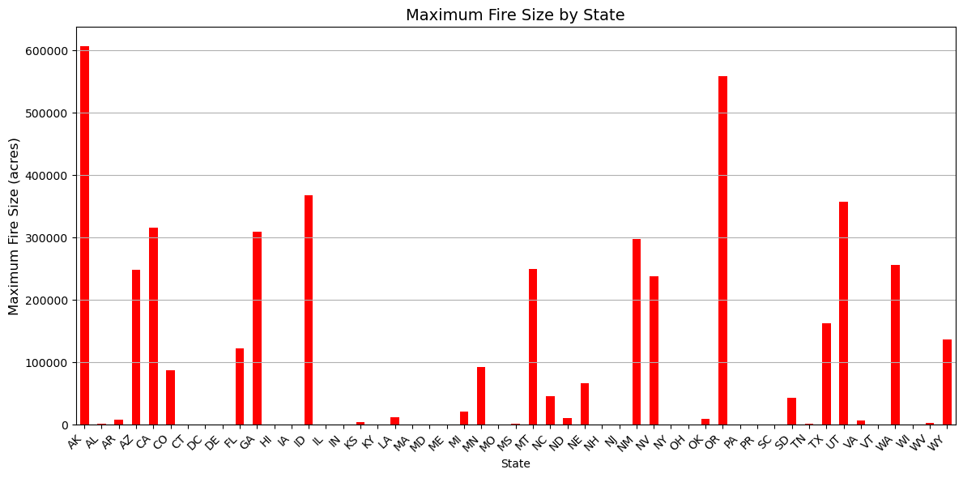
What state’s have the Biggest fires?
My states with the biggest fires in order.
1. Oregon with a 558,198.3-acre fire.
2. Montana with a 249,562-acre fire.
3. Nebraska with a 66,745-acre fire.
4. South Dakota with a 43,639-acre fire.
5. Kansas with a 4,190-acre fire.
6. Tennessee with a 2,115-acre fire.
7. Illinois with a 600-acre fire.
8. South Carolina with a 480-acre fire.

